Slide 1


Job Interview Preparation
SESSION V: CAREER EXPLORATION

Slide 2
Chapter outlines
Preparing Effectively for a Job Interview
Job Interview Types and Techniques
Interview Questions

Slide 3
LEARNING OBJECTIVES
By the end of this section, you will be able to:
Describe effective strategies to prepare for an interview
Differentiate between different types of interview situations and identify appropriate interview techniques for each
Analyze different question types common in interviews

Slide 4
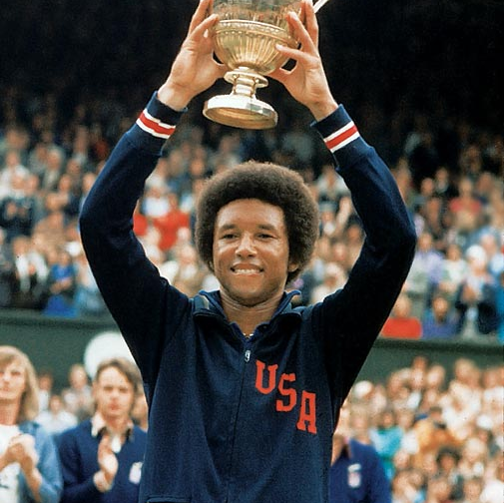
One important key to success is self-confidence. An important key to self-confidence is preparation.
Arthur Ashe, champion tennis player

Slide 5

1. Preparing Effectively for a Job Interview
If your résumé and cover letter have served their purposes well, you will be invited to participate in an interview with the company or organization you’re interested in.

Slide 6
Interviewing for a Job
Preparation
Participation
Types of interviews

Slide 7

Steps for preparing effectively for a job interview
Review the Job Description
Research the Company or Organization
Practice Answering Common Questions
Plan to Dress Appropriately
Come Prepared
Be Confident

Slide 8

Participating in an Interview
Greet the interviewer.
Shake hands.
Sit when asked.
Respond in a businesslike manner.
Maintain eye contact.
Be alert to signals the interview is ending.
Express appreciation for the time.
Ask when you will receive notice of the decision.
Shake hands.

Slide 9
2. Job Interview Types and Techniques
Screening Interviews
Phone or Web Conference Interviews
One-on-One Interviews
Panel Interviews
Serial Interviews
Lunch Interviews
Group Interviews

Slide 10
ACTIVITY: WHAT MAKES YOU A GREAT FIT?
Answer the below questions:
1. What is your job title and what are you responsible for executing?
2. What is the name of the company or organization? What is its function?
3. Identify the top three reasons why you are a great fit for this job.
4. What sets you apart from the competition?
5. List the qualities, skills and values you have that match the job requirements. Provide examples to support your answers. Connect your values to the company’s values.

Slide 11

3. Interview Questions
Know the common interview questions to expect, and understand the intention behind each
Strategically craft a great answer for each question
Practice interviewing until you’re as strong as possible

Slide 12

Be ready to answer questions:
Traditional questions
Behavioral interview questions
Unacceptable questions

Slide 13
Traditional questions
Tell me about yourself.
What is your greatest strength? your greatest weakness?
Tell me about your course work. What courses did you like best? least?
Tell me about your extracurricular activities while you were in school.
What job-related skills have you developed that are crucial to this job?

Slide 14
Behavioral questions
What major problem have you faced in group projects and how have you dealt with it?
Describe a situation in which you were successful (or unsuccessful) in moti- vating someone.
Describe a situation at work or at school where you took the initiative. What was the result? How did you feel?
Describe the most difficult person with whom you have worked. How did you handle the situation?
Give me an example of a time management skill you’ve learned and how you applied it at school or at work.

Slide 15
Unacceptable questions
You don’t look like a native of this country. Where were you born?
Do you have any disabilities?
Where do you attend church?
Do you have adequate child care? Who will look after your children while you work?

Slide 16
Discussion: How to Answer
1. “Tell Me About Yourself”
2. Describe Your Current (or Most Recent) Position”
3. “Why are you looking for a new opportunity now?”
4. “What are your strengths?”
5. “What is your greatest weakness?”
6. “Why do you want to work here?”
7. “Where do you see yourself in five years?”
8. “Why should we hire you?”
9. “Do you have any questions for me?”
Notes:
https://resources.biginterview.com/blog/interview-questions-answers/

Slide 17
Purpose of Other Employment Communication
Following up on an application
Accepting an interview invitation
Following up an interview
Accepting employment
Rejecting employment
Expressing appreciation to references and others
Resigning from a job

Slide 18
Key Takeaway
Use simple, clear, and direct language; get to the point immediately.
Focus on the employer’s needs.
Maintain a balance between professionalism and friendliness.
Demonstrate enthusiasm and confidence, but don’t be presumptuous.

Slide 19


